Slide 1
Quantum Computing
On The Strange Utility of Quantum Weirdness
Evans Hedges
Notes:
The goal of today's talk is to give you a basic rigorous understanding of quantum computing.
Hopefully by the end of this we will have a basic intuition of how quantum computing might work and understand why it can outperform classical computers in certain scenarios.
Feel free to ask questions and interrupt me as we go.

Slide 2

Outline of today
What and Why of Quantum Computing (QC)
Important Properties of Quantum Mechanics for QC
Everything is Linear Algebra
Quantum Fourier Transform

Slide 3
Definitions
Quantum: Refers to the quantized nature of physics on the very small scale
Quantum Computation: Any computation done that requires the use of quantum properties that are not present in the classical world
Notes:
First a quick hand wavey definition of quantum: quantum specifically refers to the quantized nature of physics on the small scale. So for example, light isn’t a continuous wave but individual particles with quantized energy levels (photos). You get one at a time, everything is discrete.
Quantum computing can be broadly defined as any computation done that requires the use of quantum properties that are not present in the classical world.
So as you all probably know, quantum mechanics has some very strange properties that we don’t experience in our normal life. The two main ones we’ll mention today are superposition and entanglement.
If you can do it on your computer, it's not quantum computing. Quantum computing has to take advantage of one of these weird properties.

Slide 4
QC Applications
Cryptography
Quantum Simulation (Drug Discovery and Biotech implications)
Financial Modeling
Machine Learning
etc. etc. etc. etc.
Notes:
So here I’ll just mention a few notable applications of quantum computing if we can ever get it to work at scale. Almost all of these come down to taking algorithms that take exponential time on classical computers and reducing them to polynomial time algorithms.
First is cryptography. Currently internet cryptography relies on multiplication being easy and factorization being hard. That is multiplication in polynomial time, factoring in exponential time.
Quantum Computing allows for factoring in polynomial time, which is an insane speed up. So, for some context our fastest supercomputer in the world would take about 300 Trillion years to crack RSA-2048 bit encryption (a very strong encryption type used on the internet) while a quantum computer using only ~5k qubits could do this task in about 10 seconds.
Another notable application is in simulating quantum systems. I haven’t personally explored this avenue much, but I do know there are huge implications for understanding protein folding, drug discovery, and all sorts of pharma and biotech applications.
This area is what I’m most excited about because as far as I can tell it has the highest potential for radically changing the world in a positive way.
Finally wanted to mention that there are financial modeling applications (Goldman Sachs is looking to get a quantum computer in ~5 years to run Monte Carlo simulations for derivatives pricing).
Also there’s some work being done trying to apply quantum computing techniques to machine learning (which is really just an optimization problem) with some promising preliminary ideas/results. And lots lots more.
Wanted to mention here that quantum computing isn't a silver bullet that can compute everything instantly. For example there is this thing called "post-quantum cryptography" which decsribes the cryptographic methods that we can use that quantum computers still take exponential time to crack.
QC doesn't solve all problems instantly, it just expands the universe of problems we can use a computer to solve in a reasonable amount of time.
Lets dive in to quantum computing now!

Slide 5
QC Intro Outline
QuBits
Superposition
Entanglement
Quantum Gates
Quantum Fourier Transform
Notes:
So I wanted to put another outline slide here so you all know where we’re going and it hopefully feels like we’re jumping around a bit less.
We have to cover a few things that may or may not seem connected at first.
The next slide we have is a brief intro to QuBits (bits but quantum)
Then we’ll talk about superposition and entanglement, both from the context of quantum computing using our QuBits
And finally we’ll start introducing quantum gates which are the analogues to the classical computing gates like “and” or “or”
Once we cover those items we’ll be able to build our first algorithm.

Slide 6

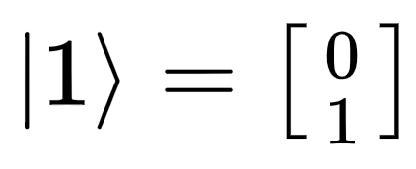
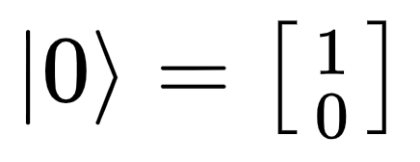
Qubits
Represented as Vectors with basis 0/1
Notes:
QuBits are the quantum equivalent to bits.
We use some property of the particle to define 0 and 1 and we want it to be binary when we measure it.
A common example (and what we’ll use today) is spin. Which when you measure it is either spin up or spin down. Here I’m going to hand wave away some quantum mechanics, but lets take it at face value today that the properties we work with have binary outcomes so we can talk about 1’s and 0’s.
We represent these properties using vectors with the basis shown on the left.
Can combine qubits using tensor products. This takes our vector quantum state and turns it into a matrix.

Slide 7
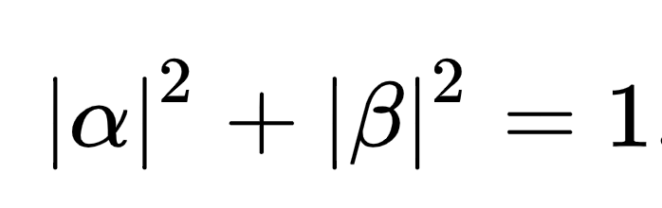
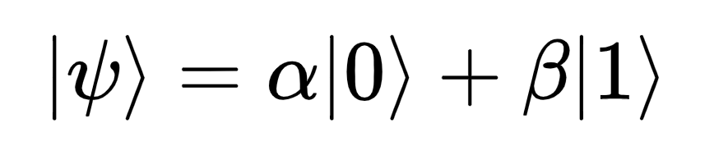
Superposition
Current state = linear combination of outcome states
Notes:
So far we haven't done anything beyond classical computers. We have a 1 and a 0 and that's it. So now we are going to start looking at the strange properties of quantum particles that we can use.
The first one we’re going to talk about is superposition. So the typical thing you hear about superposition is “it’s both up and down at the same time” But we want to be a bit more rigorous than that.
What superposition really means, is the current state of the particle is a linear combination of the possible outcome states. We also have that when the outcome is measured, it results in one of the states in probabilities given by the weights in our linear combination.
We don’t need to know why here today but when we square the weights (alpha and beta) we get the probability of measuring that state.
The cat is dead and alive at the same time -> the state of the cat is a linear combination of alpha times dead plus beta times alive.
One weird thing to mention here is that this is the state of the particle. As far as we can tell (and this is way too in depth for today to get into) the particle isn’t “secretly 1” or something, it truly is that the most accurate way to describe the particle is as this alpha 0 plus beta 1. So that’s why schrodinger’s cat is weird, the current state of the cat can only be described as alpha times dead plus beta times alive.
So that's superposition and for us today all we really need to know is the state of the particle is a linear combination of the basis vectors 0 and 1.

Slide 8
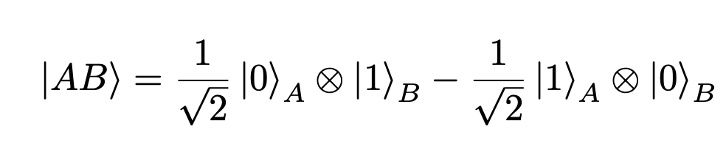
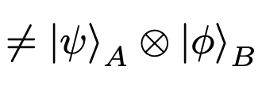
Entanglement
The state of the system cannot be described in terms of separate states of the components
Notes:
Entanglement is the other quantum property that we need to talk about. As I mentioned before, we can combine quantum states using a tensor product. This means the state of a multi-particle system can be represented as a matrix that comes from the tensor products of the constituent particles.
If the particles are all independent, we can factor this matrix state out into their individual components. So analogous to this would be polynomials that we can factor into their linear components. Instead of multiplication though, our operation here is the tensor product.
Interesting things happen, however, when the particle system gets interacted with in a way that leads the resulting matrix to be irreducible under tensor products. So our analogy here is x^2+2 which is irreducible under the reals. So if we have a matrix that describes the system and that matrix is irreducible under tensor products, that means we can’t describe the state of the individual particles on their own, which means their states are entangled.
We’re going to examine the quantum system represented here. We have particle A and particle B and we define the state of the entire system as the state we get with a 50/50 chance of finding A as 0 and B as 1 vs A as 1 and B as 0.
Although I don’t actually write out the matrix here, this system cannot be factored into a tensor product of individual states of A and B.
We can get this sort of state by using properties such as conservation of angular momentum, if we have one particle spin up and another spin down, the total system has no spin. We then interact these particles and although we don’t know which particle will be up or down, we know they have to be opposite because angular momentum needs to be preserved so the total spin has to add to 0. This is exactly what’s happening in the equation here.

Slide 9
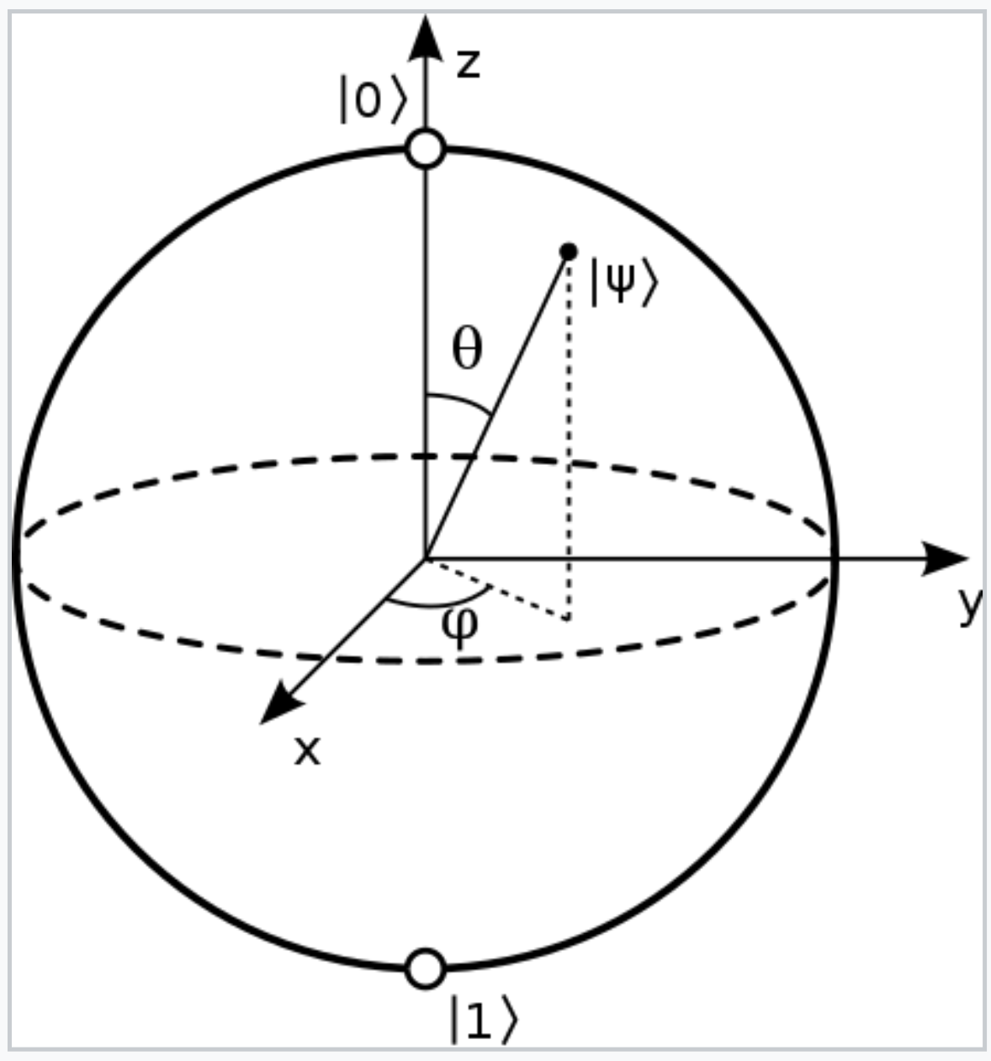
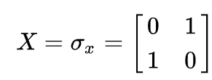
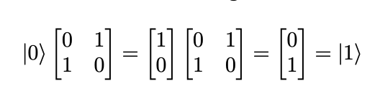
Pauli x gate (not)
Notes:
The example that we’re going to go most in depth with is the Pauli X Gate. This gate is the quantum equivalent to the NOT gate, and what it does is exactly flip our 0’s and 1’s.
So on the right here is something called the Bloch Sphere which I’m going to use to help our understanding of what’s happening here. On this diagram we have 0 representing spin up and 1 representing spin down. We can kind of think of this as where “north” is pointing.
What the Pauli X Gate does, is flip the particle pi radians (180 degrees) around the x axis represented above. So as you can see we exactly flip 0 and 1, and if we’re in a superposition we end up flipping the probability of being 0 or 1. So our alpha’s and beta’s switch.
The crucial thing here is that we can represent this gate, this rotation, as the matrix on the screen. This 0, 1, 1, 0 matrix is just going to flip our coefficients, exactly what we want it to do.
This is actually one of the key features of quantum computation, the logic gates that can be used are a large subset of nxn matricies. This gives us an insane amount of power compared to classical computation which only really allow for “and” “or” and “not”.
Notice that this gate doesn’t really do anything interesting, but the next two we’re going to talk about will.

Slide 10
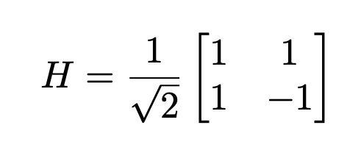
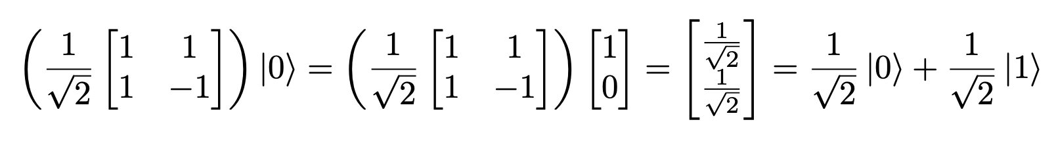
Hadamard gate
Notes:
Next up is the Hadamard gate, which is a hugely important operation for quantum computing.
This gate is the standard way of taking one of your basis states (0 or 1) and putting it into a superposition. This is a big one, it’s the superposition gate.
Lets just walk through the math here and see what happens when we pass a "0" qubit through the Hadamard gate.

Slide 11
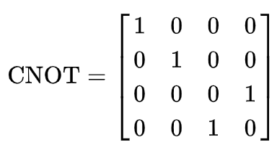
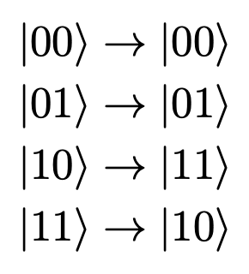
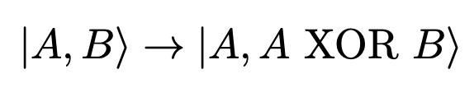
CNOT (Controlled not)
Notes:
So we’ve now got our not gate, and our superposition gate. Next up is our entanglement gate the ”CNOT” or controlled not gate.
What this gate does is takes 2 particles and based on the first particle it either leaves the second particle alone or not’s the second particle. *explain right side of screen
One way to think about this is we send |AB> to |A, A xor B> where xor is exclusive or.
The controlled here means you act on the second qubit based on the first qubit. You can do controlled any kind of gates, for example a controlled Hadamard gate

Slide 12
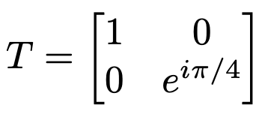
T Gate
Notes:
As im sure you all can tell by now, basically all these gates are just matricies. So from now on we’ll just be using the matrix representation of these gates. The final gate we’re going to mention is the T gate which we represent as above.

Slide 13
Quantum Fourier Transform (QFT)
Discrete Fourier Transform (and inverse) have a huge number of applications
Inverse Discrete FT has O(n2^{n}) complexity
QFT O(n²)
Notes:
Discrete Fourier transforms are used in all sorts of applications. They’re one of the efficient ways we have to use computers to solve differential equations and multiply integers. So, being able to compute the inverse as quickly as we can compute the forward discrete Fourier transform would allow us to reverse a ton of fast algorithms we have, including multiplication of large integers.

Slide 14
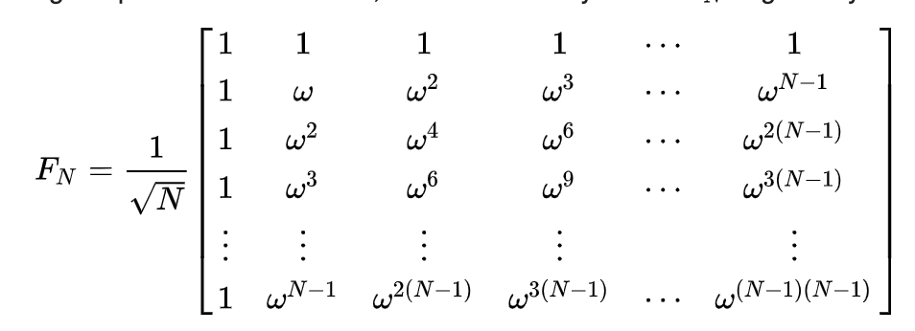
Quantum Fourier transform (QFT)
N = 2^{n}
Notes:
So we’re not going to get too into it here, but the inverse FT on n bits can be represented as this matrix where omega is the (capital) Nth root of unity.
So since we can represent this as a matrix with complex entries that are all roots of unity, I have a feeling you all know where we’re going to go with this.
Quantum computing is just linear algebra, so lets take n=2 (Capital N=4) and actually build this matrix.

Slide 15
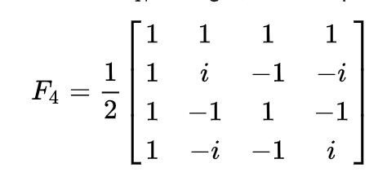
Quantum Fourier transform (QFT)
Notes:
So here I wanted to show the matrix we want to build. In the next slide we’re going to show you how to build it using the quantum gates we’ve discussed so far.
We have little n is 2 and then capital N = 4

Slide 16
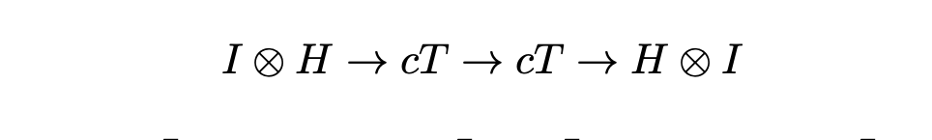
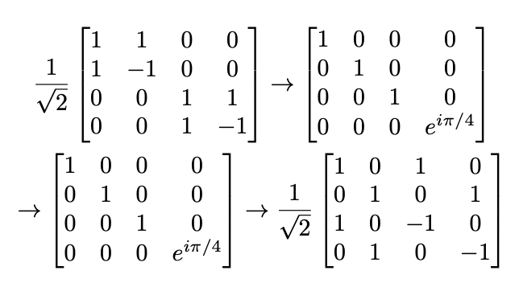
Notes:
So first what we do is apply I tensor H. This means we’re leaving the first qubit alone and applying the Hadamard gate to the second qubit. Remember here that the Hadamard gate is the superposition gate. Since we’re doing these operations separately (leaving one alone and applying the gate to the other one separately) we combine the states using a tensor product. So this is the identity tensored with the Hadamard gate.
The next thing we do is apply a “controlled T gate” and what we do here is use the first qubit as the control and apply the T gate to the second qubit. Note that the T gate just rotates our second qubit. We do this twice in a row to get the proper amount of rotation. Also remember that since this is controlled we have now entangled our qubits.
We finally apply the Hadamard gate to the first qubit and leave the second qubit alone. Again the Hadamard gate is our superposition gate. So this is a tensor product of the gates we know how to write, but since were applying the Hadamard gate to the first we do H tensor I.
Now here is what these gates look like in matrix form.

Slide 17
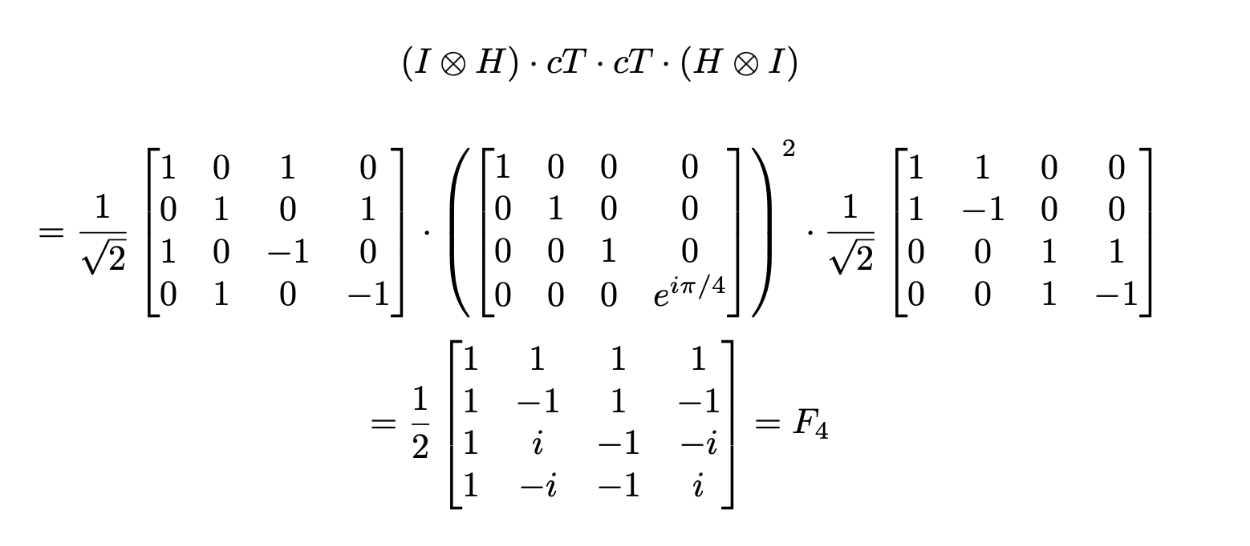
Quantum Fourier transform (QFT)
Notes:
So now we multiply them in reverse order (since we’re doing composition basically) and we get exactly what we wanted.
So here it took us 4 gates to do an inverse discrete QFT, which is on the scale of O(n^2) = 4. If we used a classical algorithm we’d have to use O(n 2^n) = 8, roughly twice the number of operations. Obviously this difference grows very quickly as n gets large.

Slide 18
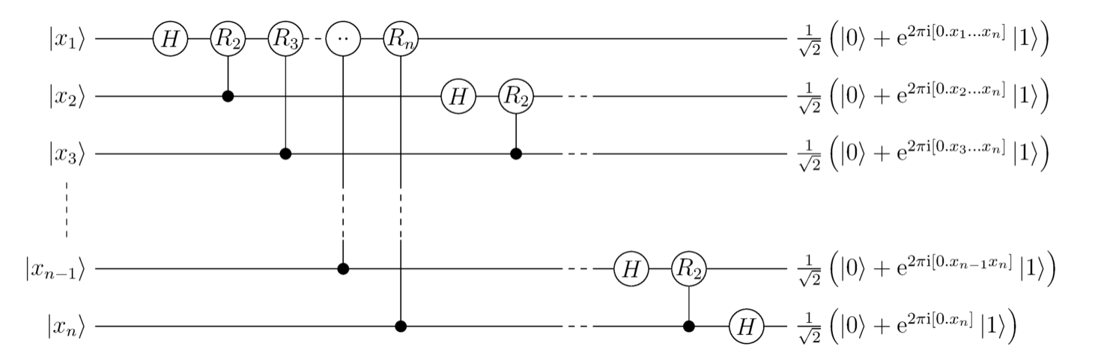
Quantum wire diagram
Notes:
So I wanted to put here that this is how we scale this algorithm where we have our qubits on the left and we read this diagram from left to right where each of these gates gets applied in the order they come up. The controlled gates are represented with the little black dot being the control qubit and the bigger R gate being the gate that gets applied.

Slide 19
Quantum Fourier transform
Notes:
The big take away I wanted to have was that this whole thing is just linear algebra.
So in one regard it’s somewhat simple in that it all we’re doing is matrix multiplication and tensor products.
But on the other hand it’s insanely powerful since we’ve moved from the classical operations of AND OR and NOT into the very powerful world of linear algebra!
I hope this helps clarify how quantum computing might allow for more powerful computation, and please let me know if you have any questions. Thank you.

